Slide 1
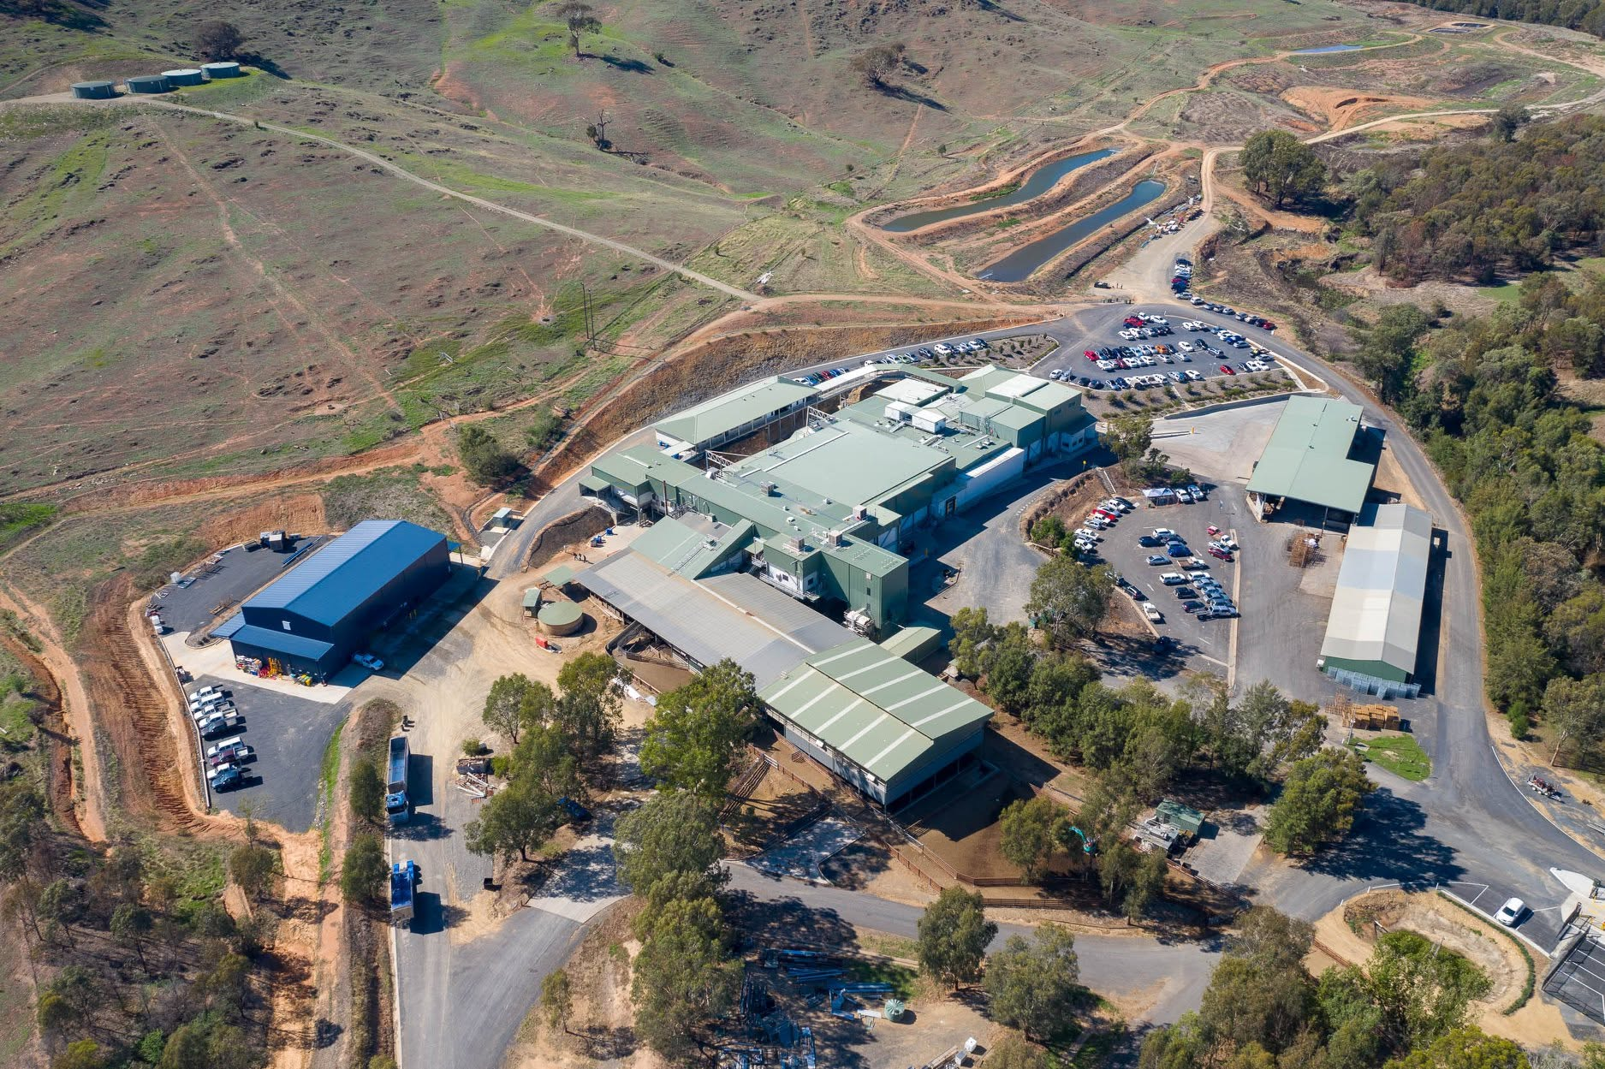

Hidden Energy. Real Returns.
Case study Gundagai Meat Processors
Staged Waste Heat Recovery and Heat Pump, as a System

Slide 2
Gundagai Meat Processors
One of Australia’s leading lamb processors
Trusted partnerships
Built on innovation, quality and long-term partnerships
with producers and customers.
Energy & refrigeration systems
Operates a medium-sized ammonia refrigeration system alongside gas-fired hot water generation for sterilisation, sanitation and cleaning.
Established in 1974
By the Barton family. A family-owned lamb
processor based in Gundagai, NSW
~1M sheep & lambs
25,000 t/HSCW processed annually
350 (FTE) employees
~20 active exporting countries

Slide 3
Gundagai Meat Processors
One of Australia’s leading lamb processors
Trusted partnerships
Built on innovation, quality and long-term partnerships
with producers and customers.
Energy & refrigeration systems
Operates a medium-sized ammonia refrigeration system alongside gas-fired hot water generation for sterilisation, sanitation and cleaning.
Established in 1974
By the Barton family. A family-owned lamb
processor based in Gundagai, NSW
~1M sheep & lambs
25,000 t/HSCW processed annually
350 (FTE) employees
~20 active exporting countries

Slide 4


GMP Challenges
Rising costs and ageing infrastructure could no longer be solved by adding boiler capacity alone
Capacity
Under Pressure
Looming
Capital Cost
Rising
Gas Prices

Slide 5

GMP Challenges
Rising costs and ageing infrastructure could no longer be solved by adding boiler capacity alone
Capacity
Under Pressure
Looming
Capital Cost
Rising
Gas Prices
2 MW boiler
Regularly operating at or above capacity
15°C winter water
Increased heating demand
82°C sterilisation temperature
Difficult to maintain occasionally
interrupting production
$400,000 capital cost
To upgrade the existing boiler
2.5 MW boiler
Required to keep pace with production growth,
with no improvement to energy efficiency
+50%
Increase in GMP’s gas price at contract renewal
$18/GJ
Representative delivered gas price with
little near-term relief

Slide 6
THE PROBLEM
This combination of rising fuel costs and looming capital expenditure prompted GMP to look for an alternative to simply increasing boiler capacity.
THE SOLUTION
A Staged Heat Recovery and Heat Pump

Slide 7
A Staged Heat Recovery Philosophy
Closed-loop, isolated water circuit —
plate heat exchangers, continuous
pH monitoring, automated alarms and independent isolation valves keep process water fully protected from refrigeration fluids.
Every degree gained passively reduces the energy needed at the next stage
Stage 1A Condenser & Oil Cooling
IN OPERATION
CONDENSER
OIL COOLING
50°C
15°C
50°C
15°C

Slide 8
Closed-loop, isolated water circuit —
plate heat exchangers, continuous
pH monitoring, automated alarms and independent isolation valves keep process water fully protected from refrigeration fluids.
A Staged Heat Recovery Philosophy
Every degree gained passively reduces the energy needed at the next stage
Stage 1B Compressed Air Recovery
FUTURE
CONDENSER
OIL COOLING
COMPRESSED
AIR RECOVERY
52.5°C
50°C
15°C
50°C
52.5°C

Slide 9
Closed-loop, isolated water circuit —
plate heat exchangers, continuous
pH monitoring, automated alarms and independent isolation valves keep process water fully protected from refrigeration fluids.
A Staged Heat Recovery Philosophy
88°C
Every degree gained passively reduces the energy needed at the next stage
Stage 2 Industrial Heat Pump
FUTURE
CONDENSER
OIL COOLING
COMPRESSED
AIR RECOVERY
INDUSTRIAL
HEAT PUMP
52.5°C
15°C
50°C
52.5°C
88°C

Slide 10
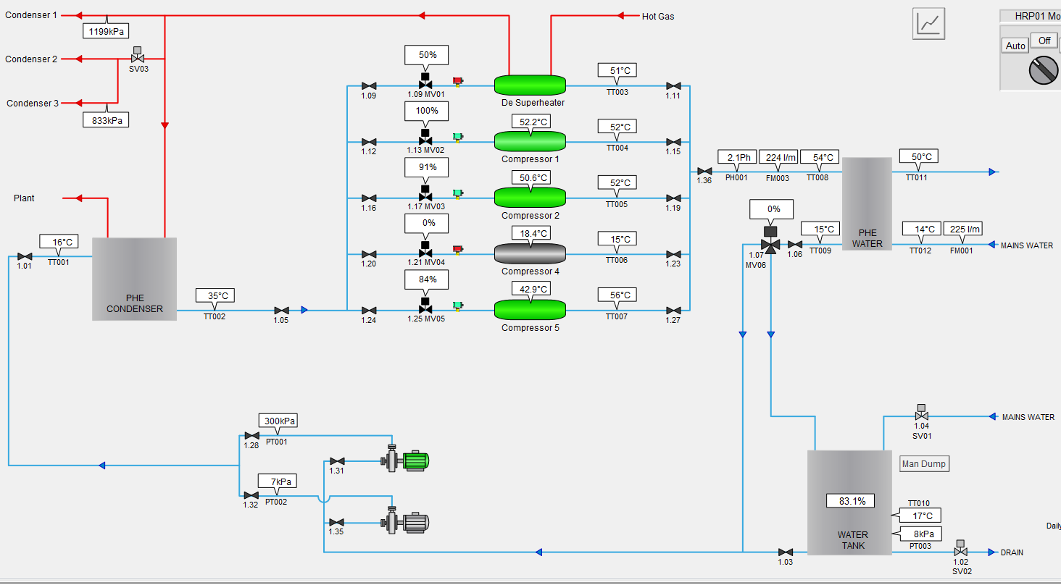
Stage 1A Condenser & Oil Cooling Recovery
The system operating today

Slide 11
Performance
CONDENSER
OIL
COOLING
COMPRESSED
AIR RECOVERY
INDUSTRIAL
HEAT PUMP
STAGE 1A
Condenser + Oil Cooler
STAGE 1B
Compressed Air
STAGE 2
Heat Pump
Combined
IN OPERATION
FUTURE
Avg heating load | 671.3 kW | 68.0 kW | 721.4 kW | 1460.6 kW
Cooling load |  |  | 478.0 kW | 478.0 kW
Power | 3.0 kW | 0.5 kW | 113.0 kW | 116.5 kW
Coefficient of performance
Heating | 223.75 | 135.92 | 6.38 | 12.54
Cooling |  |  | 4.23 | 4.10
Combined | 223.75 | 135.92 | 10.61 | 16.64
Gas offset | ~ 30 % | ~ 4 % | ~ 66 % | 100 %

Slide 12
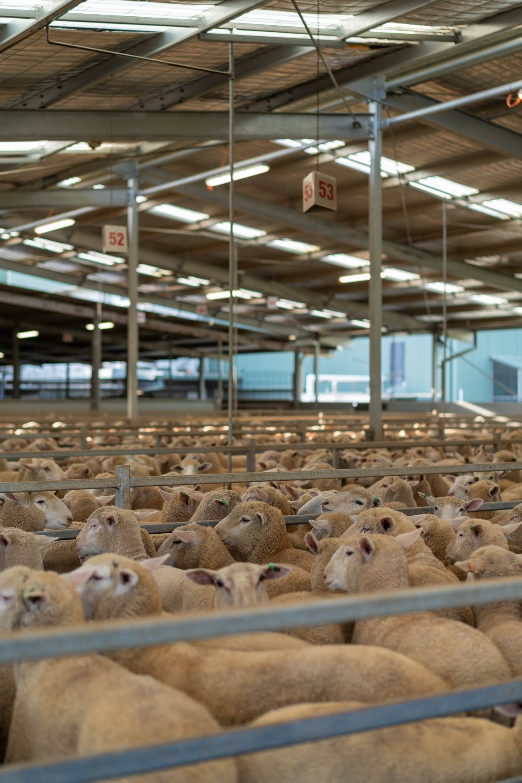
Forecast Financial Performance
Stage 1A measured and estimated benefits
All values are approximate
Cost-Avoidance Basis
Operational savings
PER YEAR
$135,500 Gas
$7,100 Condenser power
$6,900 Condenser water use
$1,300 Wastewater discharge
Capital costs
AVOIDED
$400,000 Boiler
$96,000 Condenser capacity
Future stages
SAVINGS PER YEAR
$10,000 Stage 1B
$108,000 Stage 2
Additional savings expected as future stages further increase gas displacement and system efficiency.
Cash-positive
From day one
~$400,000
Avoided boiler upgrade
~$96,000
Unrealised condenser capacity avoidance
TOTAL
TOTAL
TOTAL
$150,800
$496,000
$118,000

Slide 13
Return on Investment
Project Cost $450,000
Cost-Avoidance Basis
Utility Savings Only
Cash-positive
From day one
3 years
Approximate payback
~$400,000
Avoided boiler upgrade
~$150,800
Combined utility savings
~$96,000
Condenser capacity avoidance
$540/day 30 GJ/day
Gas savings

Slide 14
Return on Investment
Project Cost $450,000
Cost-Avoidance Basis
Utility Savings Only
Utility Savings + Incentives
Cash-positive
From day one
3 years
Approximate payback
2 years
Approximate payback
~$400,000
Avoided boiler upgrade
~$150,800
Combined utility savings
~$150,000
Benefit from energy efficiency certificates (ESCs)
~$96,000
Condenser capacity avoidance
$540/day 30 GJ/day
Gas savings

Slide 15
Return on Investment
Project Cost $450,000
Utility Savings Only
Stage 1 Non Render
Utility Savings + Incentives
STAGE 1A
STAGE 1B
3 years
Approximate payback
2 years
Approximate payback
CONDENSER
OIL
COOLING
COMPRESSED
AIR RECOVERY
~$150,800
Combined utility savings
~$150,000
Benefit from energy efficiency certificates (ESCs)
$540/day 30 GJ/day
Gas savings
Eligible incentive mechanisms
Subject to jurisdictional requirements
ESCs NSW Energy Savings Certificates
VEECs Victorian Energy Efficiency Certificates
ACCUs Australian Carbon Credit Units

Slide 16
Industry Learning
Doing Stage 1 first lowers the equipment size and running cost of Stage 2
NO ACTIVE HEAT PUMP REQUIRED
Passive recovery from
Higher baseline temperature requires
Stage 1 Non Render
Condensers
Less capacity
STAGE 1A
STAGE 1B
CONDENSER
OIL
COOLING
COMPRESSED
AIR RECOVERY
Oil coolers
Lower capital cost
Compressed air
Lower running cost

Slide 17
Industry Learning
Every gigajoule of waste heat recovered
is a gigajoule of natural gas that no longer
needs to be purchased or combusted.
Doing Stage 1 first lowers the equipment size and running cost of Stage 2
Higher baseline temperature requires
Stage 2
Less capacity
CONDENSER
OIL
COOLING
COMPRESSED
AIR RECOVERY
INDUSTRIAL
HEAT PUMP
Lower capital cost
Lower running cost

Slide 18
Site Summary
Every gigajoule of waste heat recovered
is a gigajoule of natural gas that no longer
needs to be purchased or combusted.
Doing Stage 1 first lowers the equipment size and running cost of Stage 2
Higher baseline temperature requires
RESULTS
Less capacity
Lower capital cost
Lower running cost

Slide 19
Natural Gas Reduction
Controlled ON/OFF testing confirmed sustained savings
Average gas reduction
30 GJ/day
Estimated gas savings
32% overall
7,530 GJ/annum
Estimated cost saving
$540/day
$135,500/annum
Monthly SCADA trends confirm average gas consumption has fallen consistently since heat recovery began operating.

Slide 20
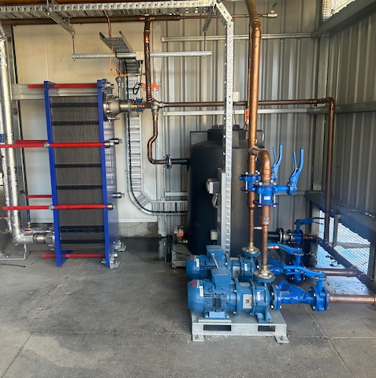
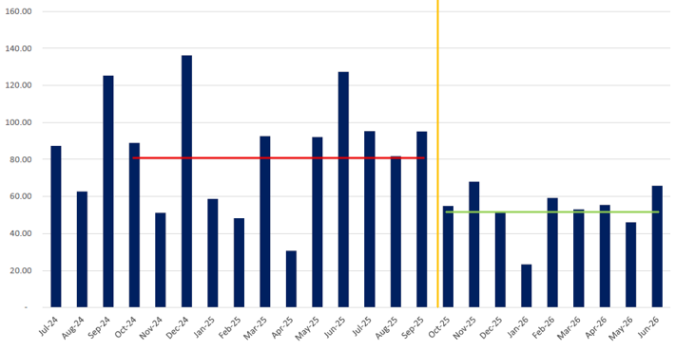
Plant Monthly Gas Usage Gigajoule
System ON Gas Usage GJ per operating day
Average operating day usage
before heat recovery turn on
Average operating day usage since heat recovery turn on
Clearly see the average usage is coming down since starting the heat recovery in October
Note
Reading Variance is due to the read date of the month
GJ Per Operating Day

Slide 21
Onsite Improvements & Performance
What GMP has seen on the ground since Stage 1A went live
Improved boiler
performance
Boiler cycles steadily between high
and low fire instead of running continuously at high fire.
Extra condenser capacity
The system acts like an additional condenser, removing heat from hot ammonia gas, equivalent to roughly
400 kW of extra capacity.
Minimal maintenance
or management
Fully automatic control via SCADA/PLC. “I have been impressed with how
little attention the system requires,
it just works.”
Free heat
Heat recovered from refrigeration condensers and compressor oil
coolers that was previously rejected
to atmosphere.

Slide 22
Thank You
Questions & Discussion
Project support and industry funding
Design, delivery and commissioning
Engineering and equipment

